Slide 1
Quantum Money from Hidden Subspaces
Scott Aaronson and Paul Christiano

Slide 2
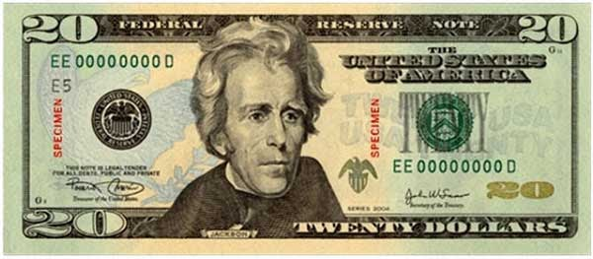
As long as there has been money, there have been people trying to copy it.
Problem: whatever a bank can do to print money, a forger can do to copy it.
Classically, we need a trusted third party to prevent double-spending…

Slide 3
The No-Cloning Theorem
There is no procedure which duplicates a general quantum state.
Can we use “uncloneable” quantum states as unforgeable currency?

Slide 4
A simple solution inspired by Wiesner [1969]:
If I randomly give you one of the two pure states…
or
…you can’t guess which I gave you with probability more than (3/4)…
…and you can’t faithfully copy it.

Slide 5
Wiesner’s Quantum Money
If I concatenate k of these states to produce
I can recognize by measuring each bit in an appropriate basis…
…but you can’t copy except with exponentially small success probability.

Slide 6
Problems with Wiesner’s Scheme
Only the bank that minted it can recognize money.
In fact, the money becomes insecure as soon as we give the users a verification oracle.
?
?
…
Modern goal: secure quantum money that anyone can verify

Slide 7
Prior Art
Aaronson, CCC’2009: Showed there is no generic counterfeiting strategy using the verification procedure as a black box.
Aaronson, CCC’2009: Proposed an explicit quantum money scheme, which was broken in Lutomirski et al. 2010.
Farhi et al., ITCS’ 2012: Proposed a new money scheme based on knot diagrams. A significant advance, but its security is poorly understood. (Even when the knot diagrams are replaced by black-box idealizations.)

Slide 8
Our Results
New, simple scheme: verification consists of measuring in just two complementary bases.
Security based on a purely classical assumption about the hardness of an algebraic problem.
A “black-box” version of our scheme, in which the bank provides perfectly obfuscated subspace membership oracles, is unconditionally secure.
The same construction gives the first “private-key” money scheme which remains secure given interaction with the bank.

Slide 9
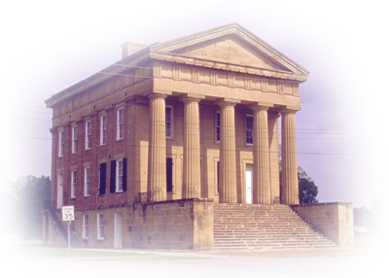
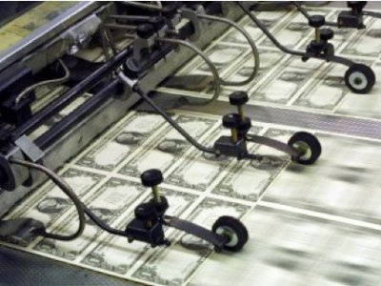
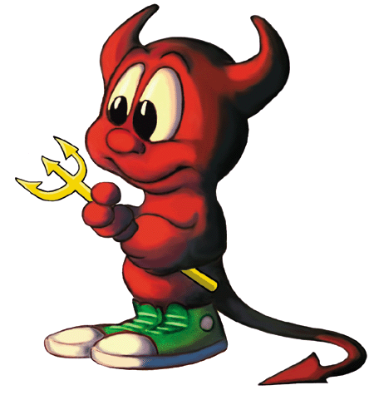

Completeness: Ver accepts valid notes w.h.p.
Soundness: If a counterfeiter starts with n notes and outputs n+1, Ver rejects one w.h.p.

Slide 10
Quantum Money “Mini-scheme”
Simplified scheme in which mint produces only one banknote.
Completeness: VerOne accepts output of MintOne w.h.p.
Public-Key Signature Scheme
Soundness: For any counterfeiter C, if
then w.h.p. either or rejects.
Full Quantum Money Scheme

Slide 11
Run KeyGen for a public key signature scheme
Must either break signature scheme, or break mini-scheme.

Slide 12
The Hidden Subspace Scheme
s is some data (TBD) which lets the user test membership in and .
Apply membership test for
Hadamard transform
Apply membership test for
Hadamard transform
Accept if both tests accept

Slide 13
Proof of “Black-Box” Security
Warm-up: Consider a counterfeiter C who doesn’t make use of s at all.
Let A and B be maximally overlapping subspaces.
But C preserves inner products.

Slide 14
Proof of “Black-Box” Security
Now consider a counterfeiting algorithm C which uses s as a “black box”:
C has access to a different black box on different inputs.
If C applies the black box to , it drives the inner product to 0!

Slide 15
Inner-Product Adversary Method
Idea: Pick a uniformly random pair of (maximally overlapping) subspaces. Bound the expected inner product.
Any approximately successful counterfeiter must make Ω(2^{n/4}) queries.
For any , v almost certainly also isn’t in B.
So each query has an exponentially small impact on inner products.

Slide 16
Hiding Subspaces
Need to provide classical data which allows a user to test membership in and without revealing them.
One solution: Represent as a uniformly random system:
with
We can add any constant amount of noise.
To generate: sample polynomials which vanish
when , then apply a change of basis.

Slide 17
Proof of Security
Conjecture: Given our obfuscations of and , no efficient quantum algorithm recovers a basis for with probability .
Suppose there were an efficient forging algorithm F. Then we can violate the conjecture:

Slide 18
Status of Hardness Assumption
If , recovering given noisy polynomials that vanish on is equivalent to learning a noisy parity…
…but we can use a membership oracle for to remove the noise.
If , recovering from a single polynomial is related to the Polynomial Isomorphism problem.
For this is easy.
For , the problem can be solved with a single hint from , which can be obtained with probability .
For , known techniques don’t seem to work.

Slide 19
Quantum + Hardness Assumptions
Most quantum cryptography tries to eliminate cryptographic assumptions.
But quantum money requires both:
If an adversary keeps randomly generating forgeries, eventually they’ll get lucky.
Combining hardness assumptions with the uncertainty principle may make new primitives possible.
Money
Copy-protection
Obfuscation?
…?

Slide 20
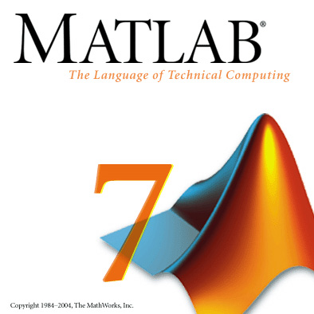
Software Copy-Protection
Classical software can be freely copied.
To prevent copying, a vendor must interact with the user on every execution.
Can we design quantum “copy-protected” software?

Slide 21



Completeness: w.h.p.
Soundness: A pirate can’t output two states either of which can be used to evaluate .
Caveats: Might be able to guess , might be able to learn an approximation to …

Slide 22
Black-Box Copy-Protection Scheme

Slide 23
Sketch of Security Proof
Goal: construct a simulator, which uses Pirate to learn C OR find an element of and an element of
If we halt both, we recover elements of and , which is ruled out by the inner product adversary method.
(We can simulate Pirate using oracle access to C)
So one of them runs successfully without using the oracle. Therefore C is learnable, and we can’t hope to stop Pirate!
If is queried for some , halt and record .
If is queried for some , halt and record .
Key idea: To make meaningful use of the oracle, must use both an element of and an element of .

Slide 24
Program Obfuscation?
Challenge: Given C, produce Obfuscation(C), which allows the user to evaluate C but learn nothing else.
Known to be impossible classically…
…but the possibility of quantum obfuscation remains open (even of quantum circuits!)

Slide 25
Completeness: w.h.p.
Soundness: any measurement can be simulated using only black-box access to C.
Makes an arbitrary measurement of
Makes an arbitrary measurement of
Simulated by simulator with black-box access to C

Slide 26

Program Obfuscation?
The state acts like a non-interactive 1-of-2 oblivious transfer.
Q: Can we implement Yao’s garbled circuits, with hidden subspaces as secrets instead of encryption keys?
A: Yes, but hard to determine security.

Slide 27
Open Questions
Break our candidate money scheme based on multivariate polynomials (?)
Come up with new implementations of hidden subspaces
Copy-protection without an oracle
Program obfuscation
Given oracle access to a subspace, prove you can’t find a basis with probability .

Slide 28
Questions?

